Slide 1

Chapter 4
Making a Living
Notes:
For a better classroom presentation flow, the order of some topics in this lecture outline differs slightly from the order of topics in the text and, where this occurs, some figures and tables are out of numerical order.

Slide 2
Learning Objectives
4.1 Describe how cultural anthropologists study economic systems.
4.2 Compare and contrast the five modes of livelihood.
4.3 Identify how the five modes of livelihood are changing.

Slide 3
Culture and Economic Systems
4.1 Describe how cultural anthropologists study economic systems.
Categorizing Livelihoods
Modes of Livelihood and Globalization

Slide 4
Categorizing Livelihoods
What is an economic system?
Includes three components
  Livelihood (or production)
    Providing for basic needs and other needs by procuring goods or making money
  Consumption
    Using up goods or money
  Exchange
    The transfer of goods or money between people or institutions

Slide 5
Modes of Livelihood and Globalization
Western capitalism has marked effects on all other livelihood patterns it meets
Increasing focus of research is how global and local economic systems are linked
Low-income countries are at a disadvantage to high-income countries

Slide 6
Making a Living: Five Modes of Livelihood (1 of 2)
4.2 Compare and contrast the five modes of livelihood.
Anthropologists organize ethnographic research on economic systems into categories, called modes
A mode of livelihood is the dominant way of making a living in a culture
A particular mode may be dominant, but other modes may exist in a culture
Modes often overlap or are mixed

Slide 7
Making a Living: The Five Modes of Livelihood (2 of 2)
The Five Modes of Livelihood:
  Foraging
  Horticulture
  Pastoralism
  Agriculture
  Industrial/Digital

Slide 8
Foraging (1 of 4)
Based on using food available in nature
  Gathering, fishing, hunting
  The main economic strategy for most of human history
Maintains balance between resources and lifestyle
  Sustainable if undisturbed by outside forces

Slide 9
Foraging (2 of 4)
Today only 250,000 people support themselves using foraging primarily
Cultural survival of foragers is at risk worldwide
  Example:
    Andaman Islanders of India (Culturama, this chapter)

Slide 10
Foraging (3 of 4)
Two types of foraging (1 of 2)
  Temperate-region
    Diet: wide variety of nuts, tubers, fruits, small animals, and occasional large game
    Gender division of labor: men and women forage; men hunt large game
    Shelter: casual construction, nonpermanent, little maintenance
    Example: San people of southern Africa

Slide 11
Foraging (4 of 4)
Two types of foraging (2 of 2)
  Circumpolar-region
    Diet: large marine and terrestrial animals
    Gender division of labor: men hunt and fish
    Shelter: time-intensive construction and maintenance; some permanent
    Example: Inuit and other northern Canadian peoples

Slide 12
Think Like an Anthropologist:
The Importance of Dogs
Dogs were the first domesticated animals, dating to Europe and Russia around 18,000 years ago; longstanding importance to humans
Case study of Hare Indians of Northwest Territories, Canada, with focus on people’s relationships with their dogs
  The 14 households in the community have 224 dogs
  Dogs play a significant role in people’s economic and emotional lives
  Major topic of conversation

Slide 13
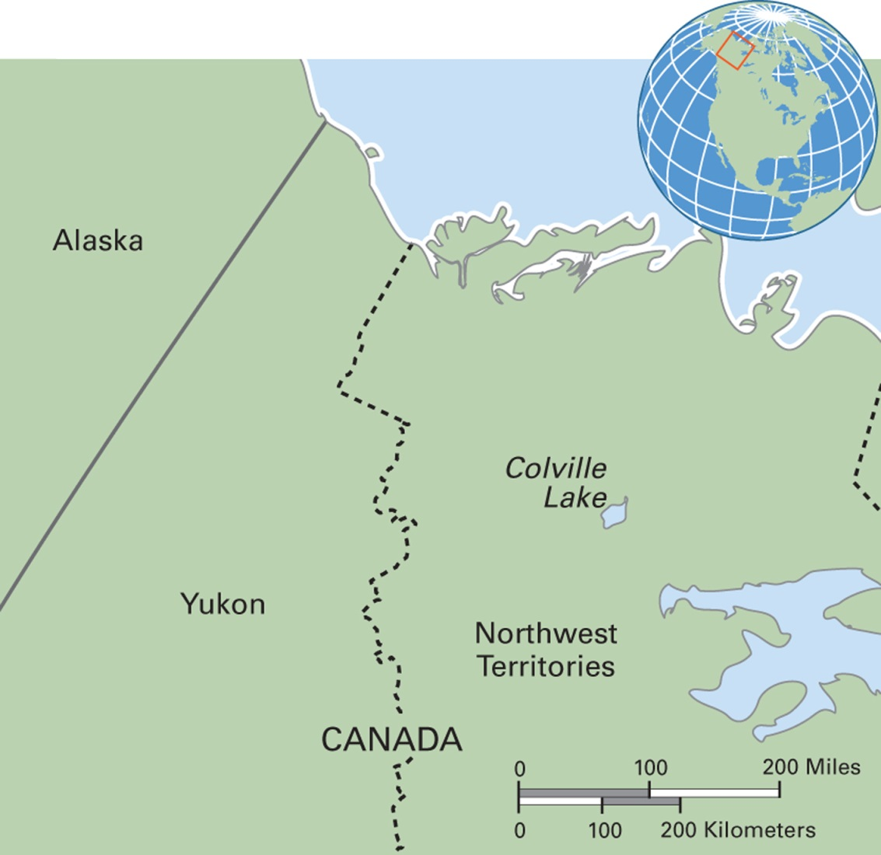
Map 4.1 Hare Region Is Near Colville Lake in Northwest Canada
Notes:
Early European colonialists named the local people Hare because of their reliance on snowshoe hares for food and clothing. The Hare people became involved in the wage-labor economy and were afflicted by alcoholism, tuberculosis, and other diseases. Efforts to reestablish claims to ancestral lands began in the 1960s. Over 600 First Nations in Canada continue to fight for rights from the Canadian government.

Slide 14
Culturama:
The Andaman Islanders of India (1 of 2)
Islands in the Bay of Bengal off the coast of Burma that belong to India
Late eighteenth century: indigenous population was 6,000 to 8,000
Now about 400
Colonialism brought contagious diseases and violence with the outsiders

Slide 15
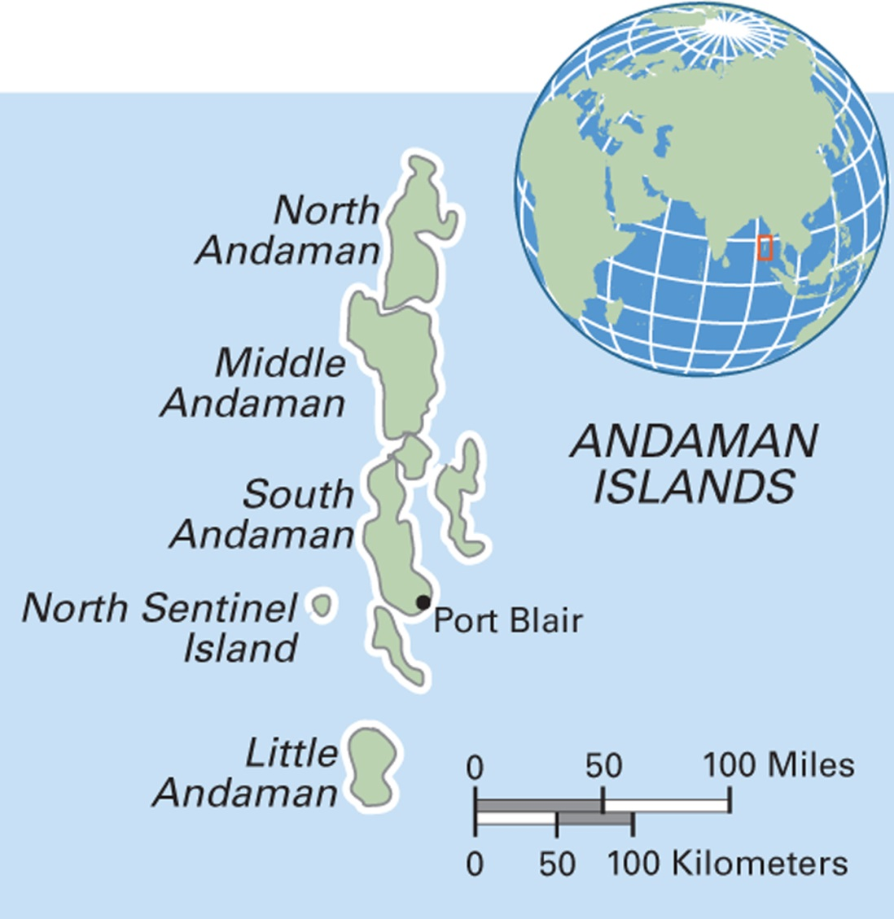
Map 4.2 Andaman Islands of India
Notes:
The 576 islands are geologically part of Myanmar and Southeast Asia. The British Empire controlled them until India’s independence in 1947.

Slide 16
Culturama:
The Andaman Islanders of India (2 of 2)
Only four surviving clusters of indigenous Andamanese exist today:
  A few dozen descendants of the so-called Great Andamanese live on a small island near Port Blair
  About 100 Onge live in one corner of Little Andaman Island
  Around 200 so-called Jarawa live in a reserved area on South Andaman
  Around 100 people, whom outsiders call the Sentinelese, live on North Sentinel Island; completely “uncontacted” so far

Slide 17
Horticulture (1 of 4)
Growing crops in gardens using hand tools
Variety of foods grown: yams, bananas, manioc, etc.
Crop yields support denser populations than foraging and allow for permanent settlements
Requirement for fallowing to provide sustainability

Slide 18
Horticulture (2 of 4)
Five Stages in Horticulture
  Clearing
  Planting
  Weeding
  Harvesting
  Fallowing

Slide 19
Horticulture (3 of 4)
Division of Labor
  A family forms the core work group
  Children work more in horticultural groups than in any other type of economy
    Caring for siblings
    Fetching fuel
    Hauling water
  Gender roles clearly defined
Examples: Iroquois, Yanomami

Slide 20
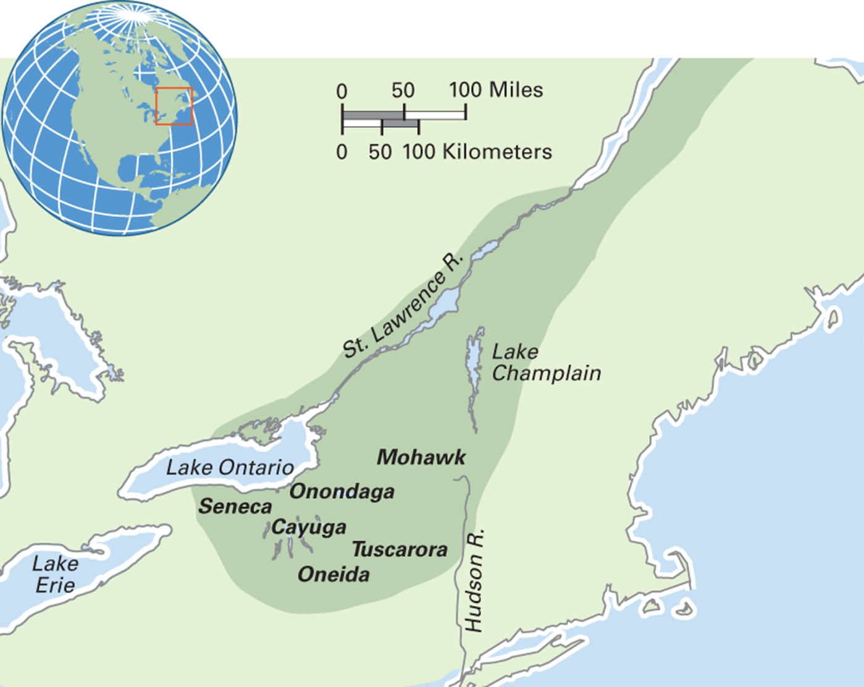
Map 4.3 Precolonial Iroquois Region
Notes:
At the time of the arrival of the European colonialists, the six nations of the Iroquois extended over a wide area. The Mohawk stood guard over the eastern door of the confederacy’s symbolic longhouse, and the Seneca guarded the western door. The six nations worked out a peace treaty and established a democracy. A great orator named Hiawatha promoted the treaty throughout the tribes, and a Mohawk woman was the first to approve it.

Slide 21
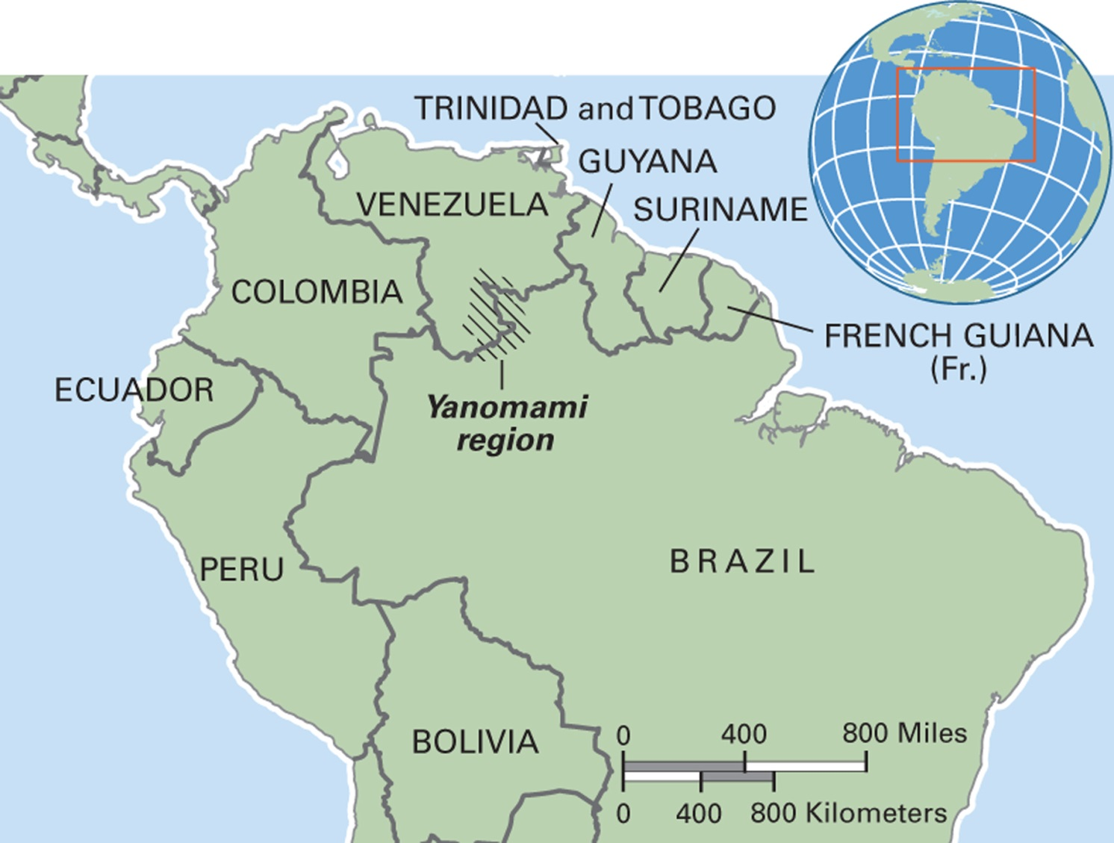
Map 4.4 Yanomami Region in Brazil and Venezuela
Notes:
The Yanomami region is supposedly protected from outsiders. But miners, ranchers, loggers, and other commercial developers have encroached on the reserve, extracting natural resources and sexually exploiting women and children.

Slide 22
Horticulture (4 of 4)
Sustainability of Horticulture
  Highly sustainable as long as fallowing system is in place and population overcrowding does not exist
  Under threat from outsiders who want the land for ranches and urban development and dam rivers to provide power for cities

Slide 23
Pastoralism (1 of 4)
Reliance on products of domesticated animal herds
Animals and their products provide over half of group’s diet
  Trade with other groups for other food and goods
Requires movement of animals to fresh pastureland for sustainability
Level of wealth and political organization varies from group to group

Slide 24
Pastoralism (2 of 4)
Division of Labor
  Families are the basic unit of production
  Little overlap between male and female tasks
  Typical division of labor:
    Men do most of herding, especially long-distance
    Women process the herd’s products
    Children help in herding

Slide 25
Pastoralism (3 of 4)
Characteristics of Pastoralism
  Spatial mobility
  Group autonomy
  Animals as private property
  Use rights regulate pastureland and migratory routes
Example: Qashqa’i of Iran

Slide 26
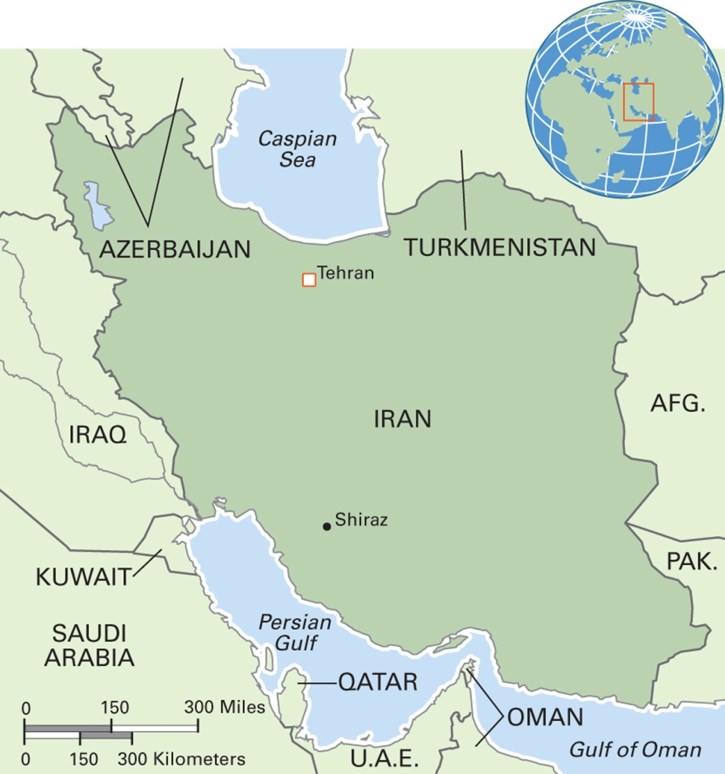
Map 4.5 Iran
Notes:
The Islamic Republic of Iran is one of the world’s most mountainous countries. Its population is over 78 million. The capital city, Tehran, has a population of over 8 million. Iran’s economy is based on oil, family farming, and small-scale trading. After Russia, Iran has the second largest natural gas reserves in the world. Tourism could be an important part of the economy. Iran has 17 listed UNESCO World Heritage sites. Another area of potential development is medical tourism because Iran’s medical system has strengths in cardiovascular surgery, fertility treatment, and organ transplantation. The official language is Persian (Farsi), and Shi’a Islam is the official state religion.

Slide 27
Pastoralism (4 of 4)
Sustainability of Pastoralism
  A sustainable system if outside forces do not encroach on herding lands and water sources
  At risk in contemporary times due to encroachment, environmental change, country boundaries

Slide 28
Agriculture (1 of 5)
Intensive strategy of production
  More labor, use of fertilizers, control of water supply, use of animals
Permanent settlements
Higher population density

Slide 29
Agriculture (2 of 5)
Division of Labor
  Families are the basic unit of production
  Productive labor is often done by men
  Women’s tasks vary by culture and type of agriculture
    Women have a central role in wet rice agricultural systems
  Children’s role varies by culture

Slide 30
Agriculture (3 of 5)
Why do men dominate productive labor in many agricultural contexts?
  Three hypotheses:
    Men and Plowing Hypothesis: Men are physically stronger and better able to complete tasks
    Women and Child Care Hypothesis: Women are not involved in heavy labor because it is incompatible with child care
    Women and Food Processing Hypothesis: Women often have responsibility for processing products near the home

Slide 31
Agriculture (4 of 5)
Two types of agriculture
  Family farming: Farmers produce mainly for their own needs but also for sale in a market system
  Industrial capital agriculture: Financial capital is used to purchase machinery that replaces human and animal labor; produces goods solely for sale

Slide 32
Agriculture (5 of 5)
Sustainability of Agriculture
  Not sustainable as typically practiced
  Heavy capital inputs and need for nonrenewable resources
  Especially true of industrial agriculture

Slide 33
Anthropology Works: Something Old,
Something New in Bolivian Farming (1 of 2)
Prehistoric form of agriculture in Bolivia
Called waru waru
Involved use of raised beds and canals
  Prevents erosion
  Retains moisture
  Protects crops against frost
Being revived in Bolivia with positive results

Slide 34
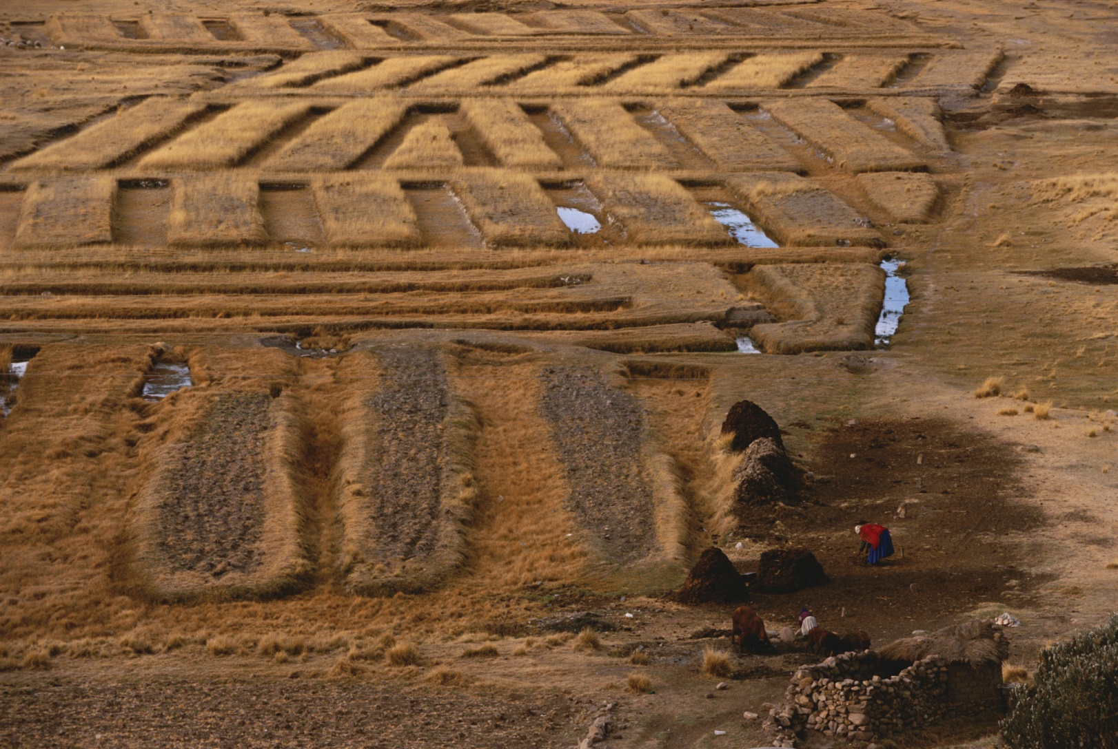
Anthropology Works: Something Old,
Something New in Bolivian Farming (2 of 2)
Notes:
Raised beds in Bolivia. This ancient strategy, now revived, helps prevent erosion, improves the organic content of the soil, captures moisture, and protects crops from frost damage. It is called waru waru in Quechua, meaning a network of canals and embankments.

Slide 35
Industrialism and the Digital Age (1 of 3)
The production of goods through mass employment in business and commercial operations
The creation, manipulation, management, and transfer of information through electronic media
Goods produced to satisfy consumer demand
Employment increases in manufacturing and service sectors

Slide 36
Industrialism and the Digital Age (2 of 3)
Two Sectors
  Formal
    Wage-based work registered in official records and statistics
  Informal
    Not officially registered and sometimes illegal
    Includes small-scale vending, illegal drugs, sex work in some contexts

Slide 37
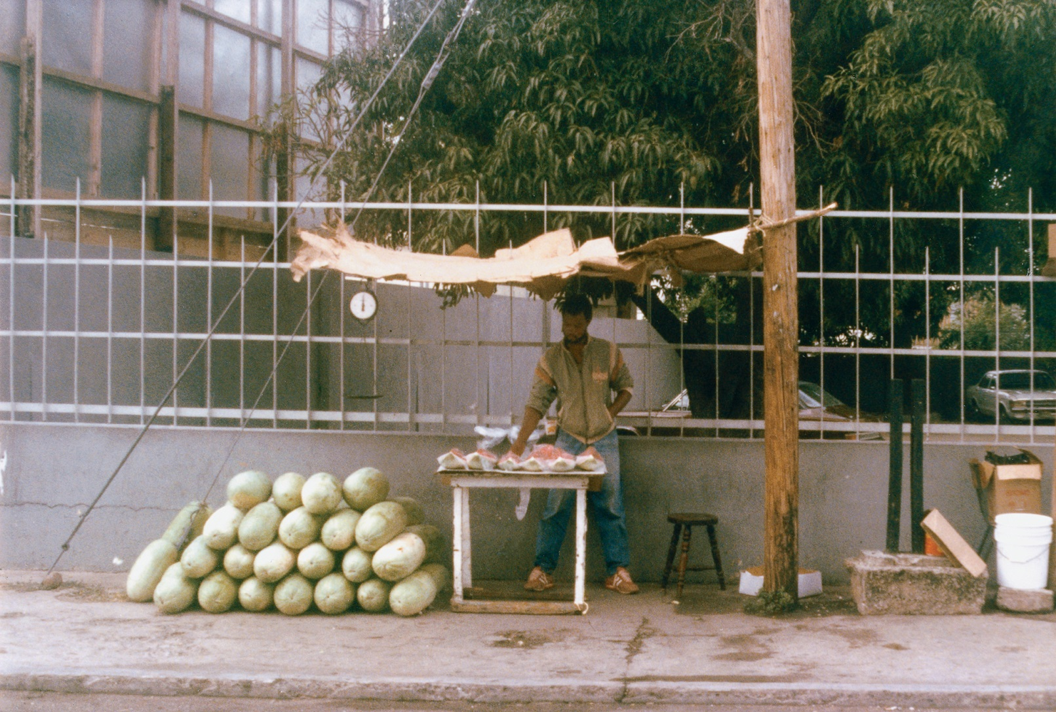
Industrialism and the Digital Age (3 of 3)
Notes:
A street vendor in Kingston, Jamaica. In many modernizing countries, city planners are taking steps to make street vending illegal on the grounds that such informal stands are unsightly.

Slide 38
Changing Livelihoods (1 of 2)
4.3 Identify how the five modes of livelihood are changing.
Foragers: The Tiwi of Northern Australia
Horticulturalists: The Mundurucu of the Brazilian Amazon
Pastoralists: The Herders of Mongolia
Family Farmers: The Maya of Chiapas, Mexico
Global Capitalism: Taiwanese Industrialists in South Africa

Slide 39
Changing Livelihoods (2 of 2)
Three effects of the spread of Western capitalism:
  Dispossession of local people and their land
  Recruitment of former foragers, horticulturalists, pastoralists, and family farmers to work in the industrial/digital sector
  Increases in export commodity production and decreases in food production for family use

Slide 40
Foragers:
The Tiwi of Northern Australia
Colonial contact had negative effects
Now settled in villages and play Western sports
Making art for sale
Working in tourism
Now attempting to reclaim their heritage

Slide 41
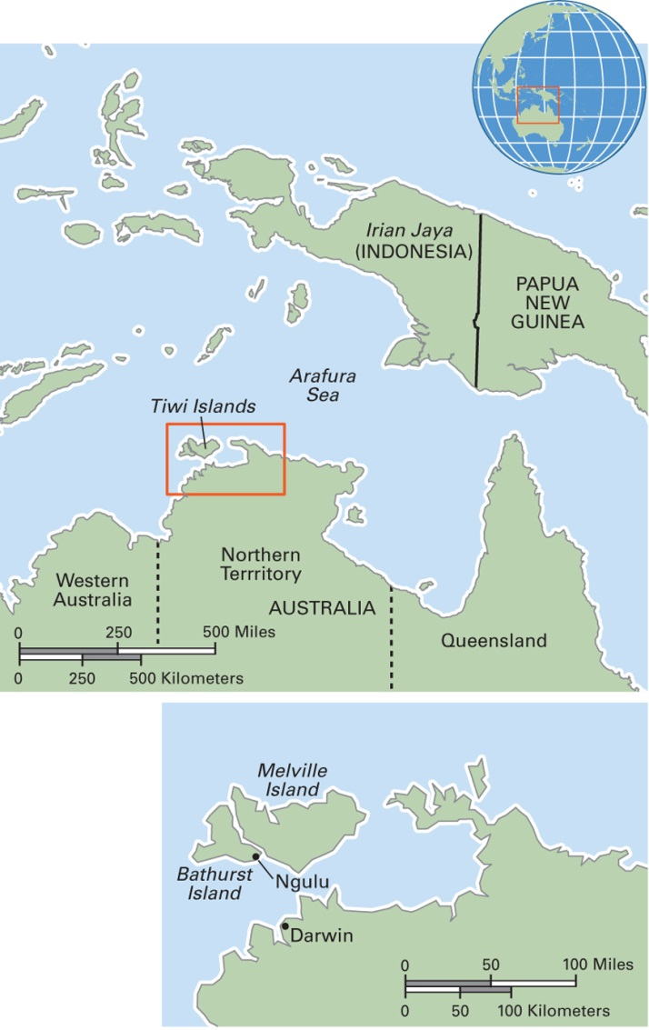
Map 4.6 Tiwi Region in Northern Australia
Notes:
The Tiwi Islands consist of Bathurst and Melville Islands. The Tiwi population is about 3,000, most of whom live on Bathurst Island. In 2001, the Tiwi Islands Local Government Area was established, launching a new era of local government.

Slide 42
Horticulturalists: The Mundurucu of the Brazilian Amazon
Involvement in the rubber industry as laborers
Migration from traditional villages to live in the rubber area
New domestic pattern of husband and wife co-residents

Slide 43
Pastoralists: The Herders of Mongolia
Mongolian rural economy based on pastoralism for centuries
Experience of dramatic changes, from private holdings to collective herds in the Soviet era and now back to private herds
Case study in Altai Mountain area in the 1990s revealed decline in herders’ standard of living with privatization

Slide 44
Family Farmers:
The Maya of Chiapas, Mexico
Restudy after 23 years revealed many changes
Change from family farming for own provisioning to involvement in market trade
More wage work and more unemployment
Many people no longer own land
Increasing social inequality

Slide 45
Global Capitalism: Taiwanese Industrialists in South Africa
Post-apartheid economic expansion
Case study of factory in KwaZulu-Natal, a state along the northeast coast, south of Mozambique
South African workers see Taiwanese management system as hierarchical and racist
Bad fit with local culture

